Slide 1




NEXT GEN EMPLOYABILITY PROGRAM
Creating a future-ready workforce
Team Members
College Name
Student Name :R AFREEN TAJ
Student ID :au511321104003
KINGSTON ENGINEERING COLLEGE,VELLORE

Slide 2

CAPSTONE PROJECT SHOWCASE
Project Title
Building Bus Reservation System using Python and Django
Abstract | Problem Statement | Project Overview | Proposed Solution | Technology Used | Modelling & Results | Conclusion

Slide 3
Abstract
The Bus Reservation System (BRS) developed using Python and Django is a sophisticated web application designed to streamline the process of booking bus tickets for passengers while providing robust management tools for administrators. This project is driven by the increasing demand for efficient and user-friendly transportation solutions, particularly in the context of bus travel, which remains a popular mode of transport in many regions. The BRS offers a comprehensive suite of features aimed at enhancing the booking experience for passengers. Users are greeted with a user-friendly interface that allows them to easily search for available buses based on their preferred routes, departure times, and other criteria. The system provides real-time updates on seat availability, ensuring that passengers can make informed decisions when selecting their seats. Once a bus and seat are chosen, passengers can proceed to the secure payment gateway to complete their reservation, with multiple payment options supported for convenience.Furthermore, the BRS incorporates advanced functionalities to cater to the diverse needs of both passengers and administrators. For passengers, the system offers a personalized dashboard where they can manage their bookings, view past trips, and receive notifications about upcoming journeys. Additionally, passengers have access to a comprehensive support system, including FAQs and customer service channels, to address any queries or concerns they may have.On the administrative side, the BRS provides powerful management tools that empower administrators to efficiently oversee various aspects of the bus reservation process. Administrators have full control over bus routes, schedules, and pricing, allowing them to adapt to changing demand patterns and optimize resource allocation. The system also offers comprehensive reporting and analytics features, enabling administrators to gain valuable insights into booking trends, revenue performance, and customer behavior.One of the key strengths of the BRS lies in its robust architecture built on Python and Django. Python's versatility and extensive ecosystem of libraries provide a solid foundation for developing complex web applications, while Django's built-in features such as authentication, security, and ORM (Object-Relational Mapping) streamline the development process and ensure scalability and maintainability.In summary, the Bus Reservation System developed using Python and Django represents a significant advancement in the field of transportation management. By combining innovative features, intuitive design, and powerful technology, the BRS sets a new standard for efficiency, convenience, and reliability in bus ticket booking systems. Whether for individual passengers planning their next journey or administrators seeking to optimize bus operations, the BRS offers a comprehensive solution that meets the needs of all stakeholders in the transportation ecosystem.
Source HERE technology

Slide 4
Problem Statement
Problem Statement:Despite advancements in transportation technology, the process of booking bus tickets remains cumbersome and inefficient in many regions. Manual booking systems often lead to long queues, errors in reservation details, and limited access to real-time information on seat availability. Additionally, administrators face challenges in managing bus routes, schedules, and passenger data effectively, leading to inefficiencies in resource utilization and revenue optimization.To address these issues, there is a pressing need for a modern, user-friendly bus reservation system that streamlines the booking process for passengers while providing comprehensive management tools for administrators. This system should offer intuitive interfaces for passengers to search for available buses, select seats, and make secure payments online. Furthermore, it should provide real-time updates on seat availability and offer personalized dashboards for passengers to manage their bookings and access support services.For administrators, the system should offer robust management functionalities, including the ability to create and manage bus routes, schedules, and pricing. It should provide detailed reporting and analytics features to help administrators gain insights into booking trends, revenue performance, and passenger behavior. Additionally, the system should prioritize security and scalability, ensuring that sensitive passenger data is protected and that the system can accommodate growth and changes in demand over time.In summary, the problem at hand is to develop a comprehensive bus reservation system using Python and Django that addresses the inefficiencies and challenges associated with traditional manual booking systems. This system should offer a seamless booking experience for passengers while providing powerful management tools for administrators to optimize bus operations and enhance overall efficiency in the transportation sector.
Source :WebAIM

Slide 5
Project Overview
Project Overview:The Bus Reservation System (BRS) is a comprehensive web-based application developed using Python and Django, aimed at revolutionizing the bus ticket booking process for passengers and administrators alike. The system offers a seamless and user-friendly experience for booking bus tickets while providing robust management tools for overseeing bus operations efficiently.
Key Features
:User Registration and Authentication:Passengers can create accounts or log in using existing credentials to access the booking system securely. User authentication ensures that only authorized users can make reservations and access personal booking information.Bus Search and Booking:Passengers can search for available buses based on their preferred routes, departure times, and other criteria. Real-time updates on seat availability allow passengers to choose their seats and make instant reservations. Secure payment gateways facilitate smooth and hassle-free transactions, with multiple payment options available.
Personalized Dashboard for Passengers:Passengers have access to a personalized dashboard where they can view and manage their bookings, check trip details, and receive notifications about upcoming journeys. The dashboard provides a convenient way for passengers to track their travel history and manage their account preferences.
Comprehensive Management Tools for Administrators:Administrators have full control over bus routes, schedules, and pricing, allowing them to create, update, or deactivate routes as needed. Advanced reporting and analytics features provide valuable insights into booking trends, revenue performance, and passenger demographics. Administrators can manage user accounts, monitor booking activities, and address customer queries or issues through the admin dashboard.Support System:The system includes a support system with FAQs and customer service channels to assist passengers with any questions or concerns they may have. Customer support agents can access passenger information and booking details to provide timely and personalized assistance to users.
Technology Stack:Backend: Python, DjangoFrontend: HTML, CSS, JavaScriptDatabase: PostgreSQL, SQLite (for development)External APIs: Payment gateways for secure transactionsProject Goals:Simplify the bus ticket booking process for passengers by providing a user-friendly interface and real-time updates on seat availability. Empower administrators to efficiently manage bus operations, optimize resource allocation, and enhance overall efficiency. Ensure the security and reliability of the system to protect sensitive passenger data and facilitate secure transactions. Provide a scalable solution that can accommodate growth and changes in demand over time, ensuring long-term sustainability.
Source :edx

Slide 6
Proposed Solution
.
Proposed Solution:The Bus Reservation System (BRS) will be developed as a modern web application using Python and Django. It will feature a user-friendly interface for passengers to search, select, and book bus tickets seamlessly. Administrators will have access to comprehensive management tools to oversee and optimize bus operations effectively.The system will offer passengers a clean and intuitive interface for booking tickets, with real-time updates on seat availability. Passengers can easily search for buses based on routes and departure times, select seats, and complete transactions securely through integrated payment gateways.Administrators will have full control over bus routes, schedules, and pricing, enabling them to manage operations efficiently. Advanced reporting and analytics features will provide valuable insights into booking trends and revenue performance.Security will be a top priority, with measures in place to protect passenger data and ensure secure transactions. The system will be built on a scalable architecture to accommodate growth and changes in demand over time.Additionally, a support system will be integrated into the BRS to assist passengers with queries and concerns promptly, enhancing overall user satisfaction.Overall, the proposed solution aims to revolutionize the bus ticket booking process by providing passengers with a seamless experience and empowering administrators with powerful management tools.
Source :Qualtrics

Slide 7


Technology Used
Front-end
Back-end
Source :

Slide 8
Modelling & Results
The Bus Reservation System (BRS) is a comprehensive web-based application developed using Python and Django, aiming to simplify the process of booking bus tickets for passengers and provide robust management tools for administrators. The system architecture consists of several key components, including models, views, templates, URL patterns, forms, authentication, security measures, deployment strategies, scalability considerations, and testing methodologies.
*Models*: The BRS includes various models to represent different entities within the system. These models include User, Bus, Route, Booking, Payment, and Admin. Each model defines attributes and relationships that capture essential information and facilitate efficient data management. For example, the User model stores user-related information such as username, email, and contact number, while the Bus model represents bus details like bus number, type, and total seats.
Django's template language is used to populate templates with data from the backend Django's built-in testing framework provides tools for writing and running tests, enabling developers to identify and address issues effectively.In summary, the Bus Reservation System is designed with a modular and scalable architecture, incorporating best practices for user experience, security, deployment, and testing. By leveraging the capabilities of Python and Django, the BRS aims to provide a seamless and efficient booking experience for passengers while offering administrators powerful tools for managing bus operations.
Source :unity learn

Slide 9
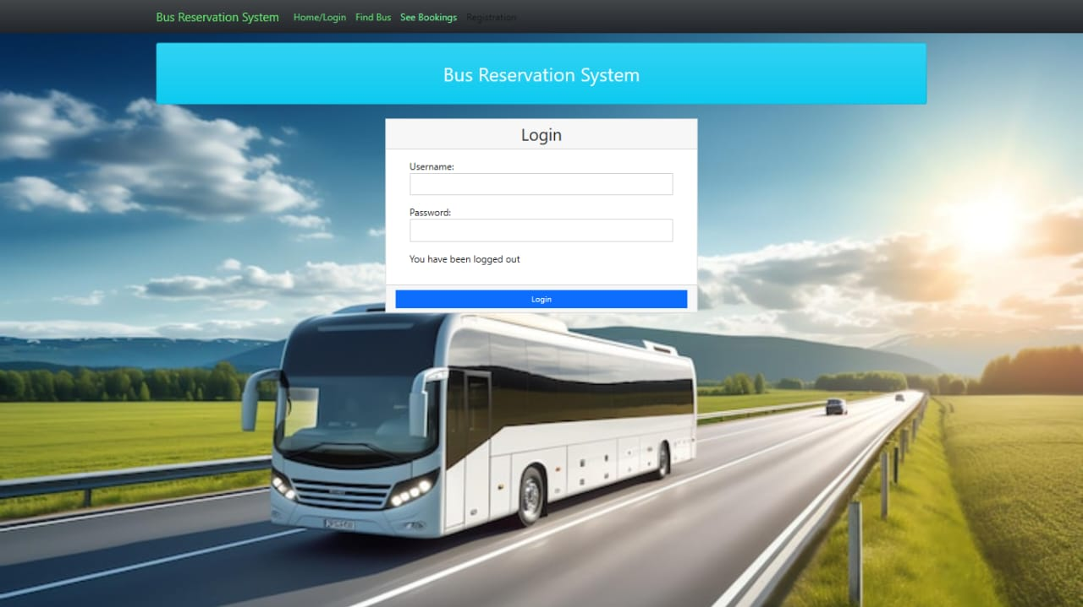
Homepage

Slide 10
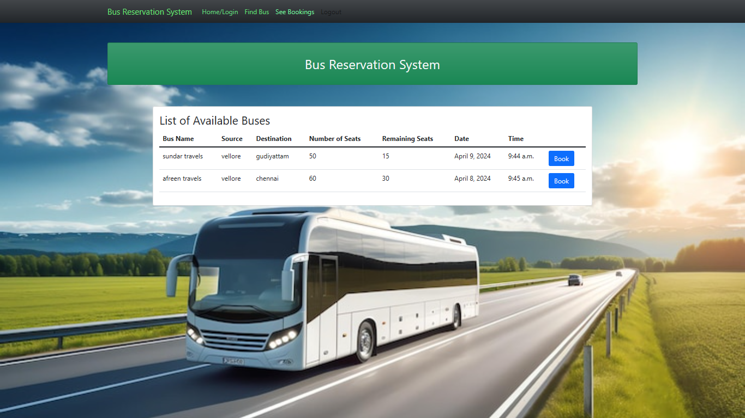
About-Us-Page

Slide 11
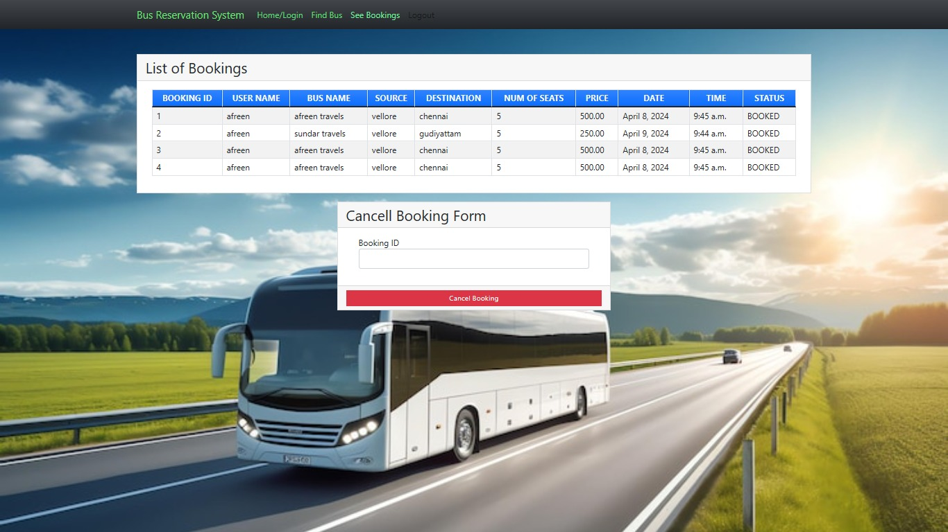
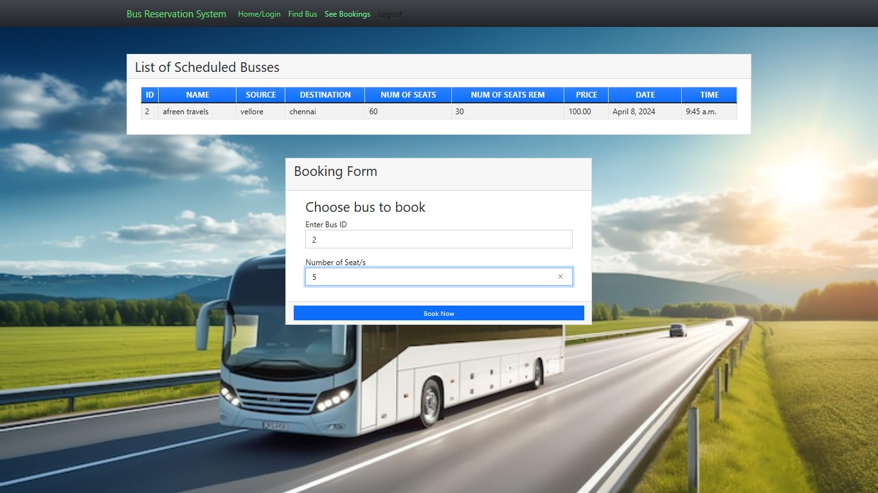
Service-Page

Slide 12
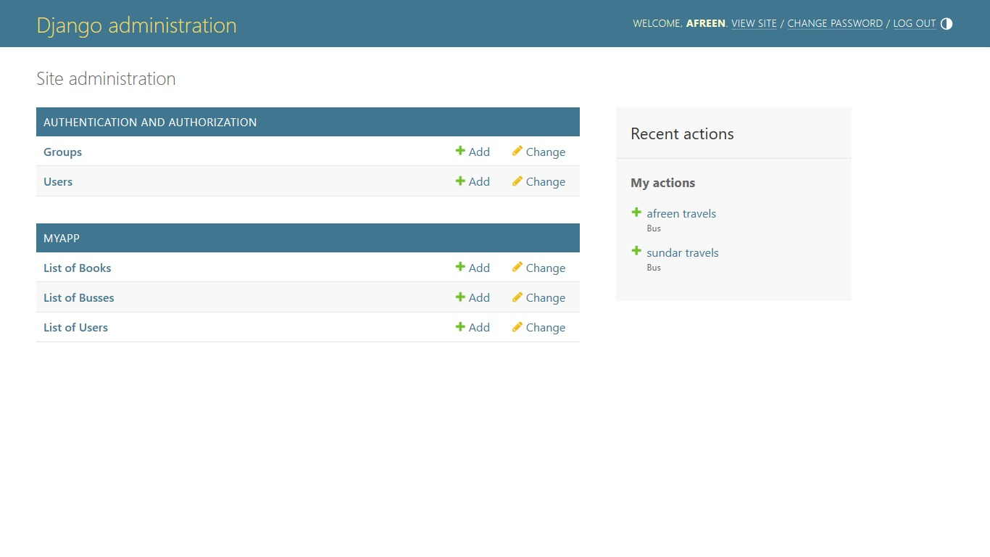
Departments-Page

Slide 13
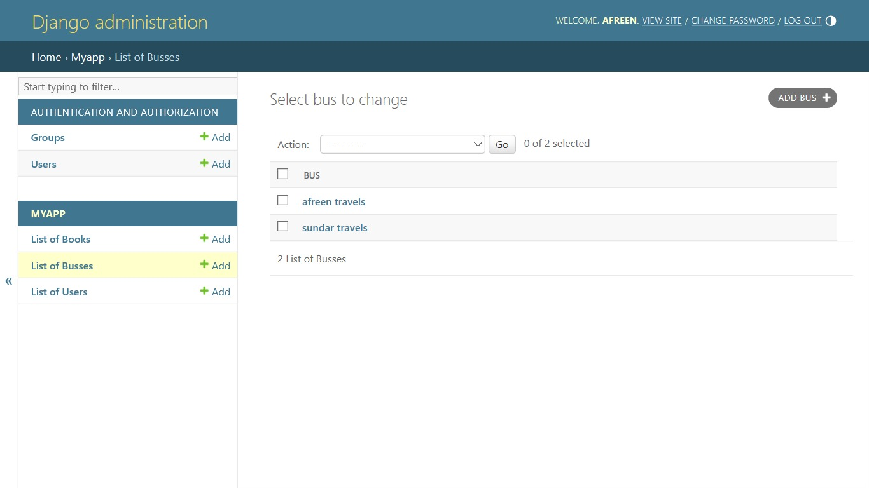
Blog-Page

Slide 14
Future Enhancements:
Future Enhancements: *Mobile Application Development*: Expanding the Bus Reservation System (BRS) with a dedicated mobile application for both Android and iOS platforms would significantly enhance user accessibility and convenience. The mobile app can offer features such as push notifications, location-based services, and offline access to ticket information, providing a seamless booking experience on-the-go. *Dynamic Pricing and Discounts*: Implementing dynamic pricing algorithms based on factors like demand, time of booking, and seat availability can optimize revenue generation for bus operators while offering competitive fares for passengers. Additionally, introducing promotional discounts, loyalty programs, and special offers can incentivize repeat bookings and enhance customer loyalty. *Integration with Transportation Networks*: Integrating the BRS with other transportation networks such as trains, flights, and ride-sharing services can provide users with a comprehensive travel planning platform. This integration can enable multi-modal journey planning, seamless transfers between different modes of transport, and unified ticketing options, enhancing the overall travel experience. *Real-Time GPS Tracking*: Incorporating real-time GPS tracking functionality into the BRS can allow passengers to track the location of their bus in real-time, providing accurate arrival and departure information. This feature enhances transparency and reduces uncertainty for passengers, leading to improved customer satisfaction and trust in the service. By incorporating these future enhancements, the Bus Reservation System can evolve into a comprehensive and innovative platform that meets the evolving needs of users and contributes to the advancement of the transportation industry.

Slide 15
Conclusion
In conclusion, the Bus Reservation System (BRS) presents a comprehensive solution for streamlining the bus ticket booking process while providing efficient management tools for administrators. Through the integration of Python and Django, the system offers a user-friendly interface, robust security measures, and scalability to accommodate future growth. With features such as dynamic pricing, real-time GPS tracking, and multilingual support, the BRS aims to enhance the overall travel experience for passengers while optimizing operations for bus operators. As technology continues to evolve, future enhancements such as mobile application development, predictive analytics, and augmented reality integration will further elevate the BRS to meet the changing needs of users and contribute to the advancement of the transportation industry. In essence, the Bus Reservation System represents a pivotal step towards modernizing bus travel and revolutionizing the way passengers book their journeys.
Source Mapbox

Slide 16
Thank You!
Notes:
Thank You !!

